Slide 1
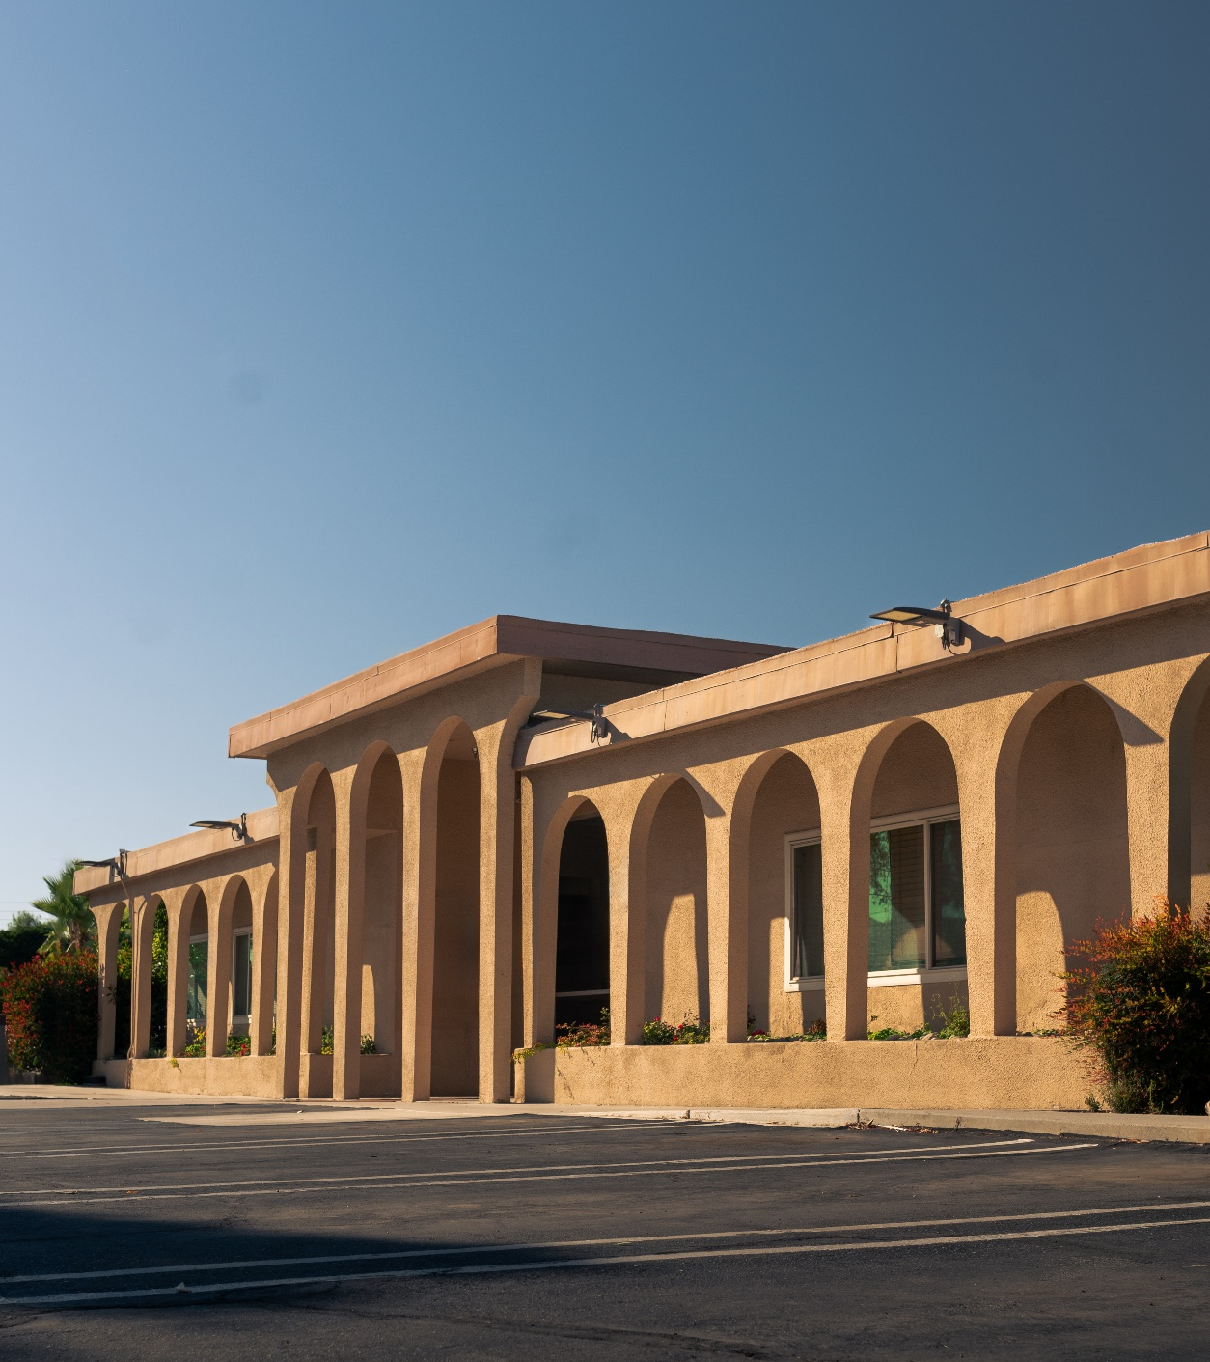


cedarhouse.org

Slide 2
OUR MISSION
We provide evidence-based treatment to empower individuals affected by addiction to find wholeness in recovery.​
OUR VISION
We envision a full continuum of care and outreach activities to achieve healing for individuals, families and communities.

Slide 3

OUR CORE VALUES

Slide 4


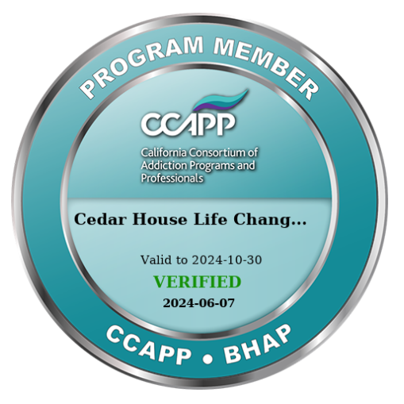
OUR STORY
Started as Amigo House in 1973 with only 12 beds
Today: We serve adult men and women
(w/ or w/o children) w/ Substance Use and
Co-occurring Disorders
Four locations across the Inland Empire
(196 Beds + Sobering Center)
All our programs are Licensed by the Department of Health Care Services​

Slide 5
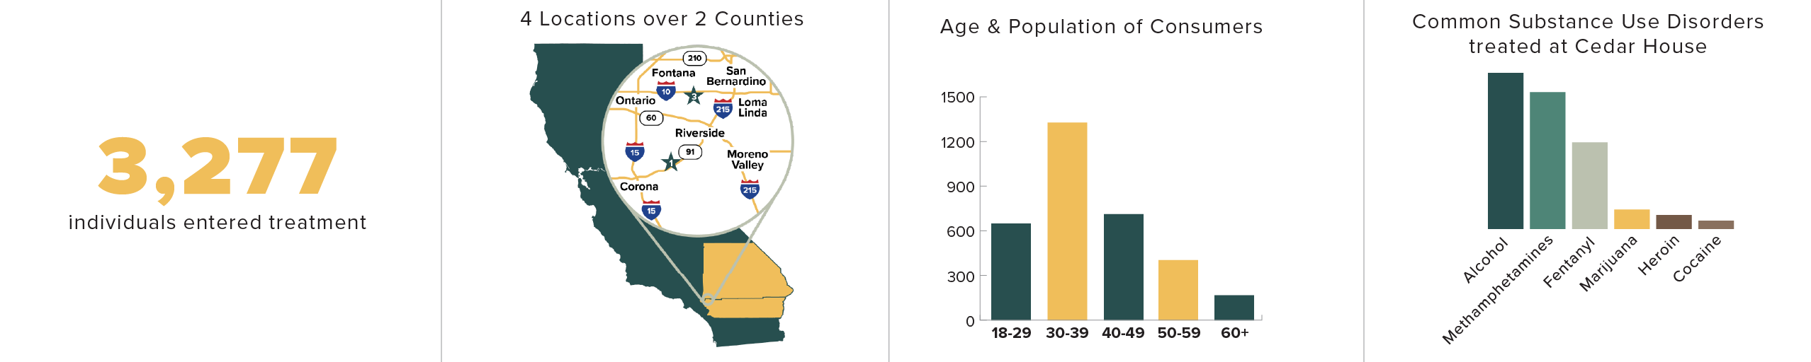
WHO WE SERVE

Slide 6

IN NETWORK WITH

Slide 7



OUR PROGRAMS
3.2
Clinically Managed Withdrawal Management
High Intensity Residential Treatment
MEDICATION-ASSISTED TREATMENT SERVICES
LOW INTENSITY RESIDENTIAL
OUTPATIENT TREATMENT
RECOVERY SERVICES
SOBERING CENTER
OVERDOSE PREVENTION TRAINING

Slide 8
TREATMENT GROUPS
Process (Core)
Anger Management
Medical Aspects
Parenting
LGBTQ Support
GROUPS:
Step Study
Co-Occurring Disorders
Trauma (Trauma Informed Care)
Family
MAT Support

Slide 9
OTHER BENEFITS
Sense of Community
Recreation
Exercise
Life & Leadership Skills
12-Step Meetings on site
Therapeutic Support

Slide 10
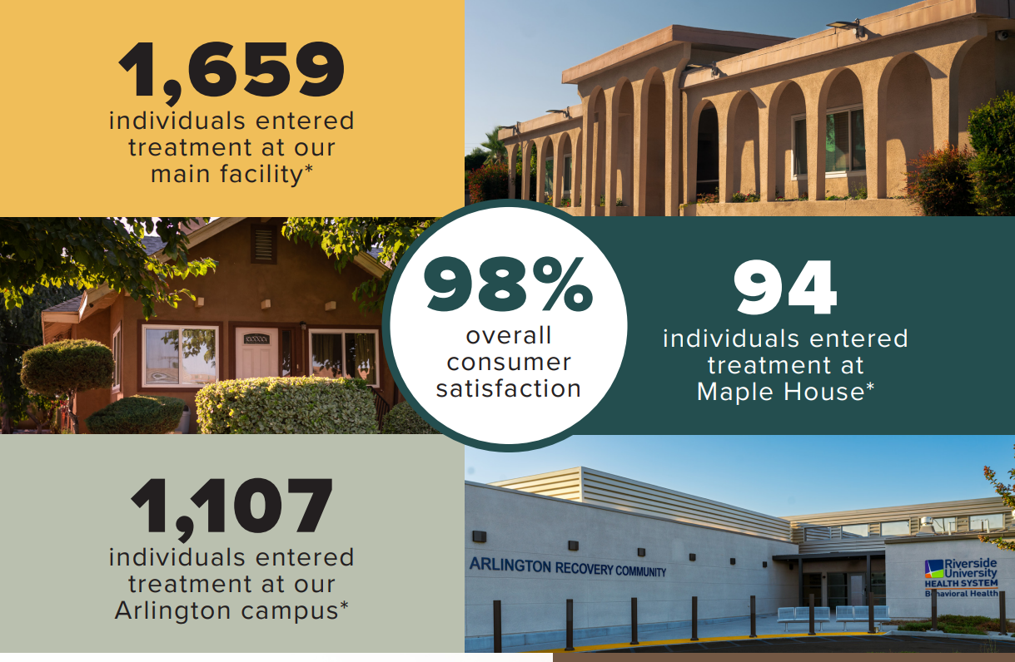
OUR IMPACT

Slide 11
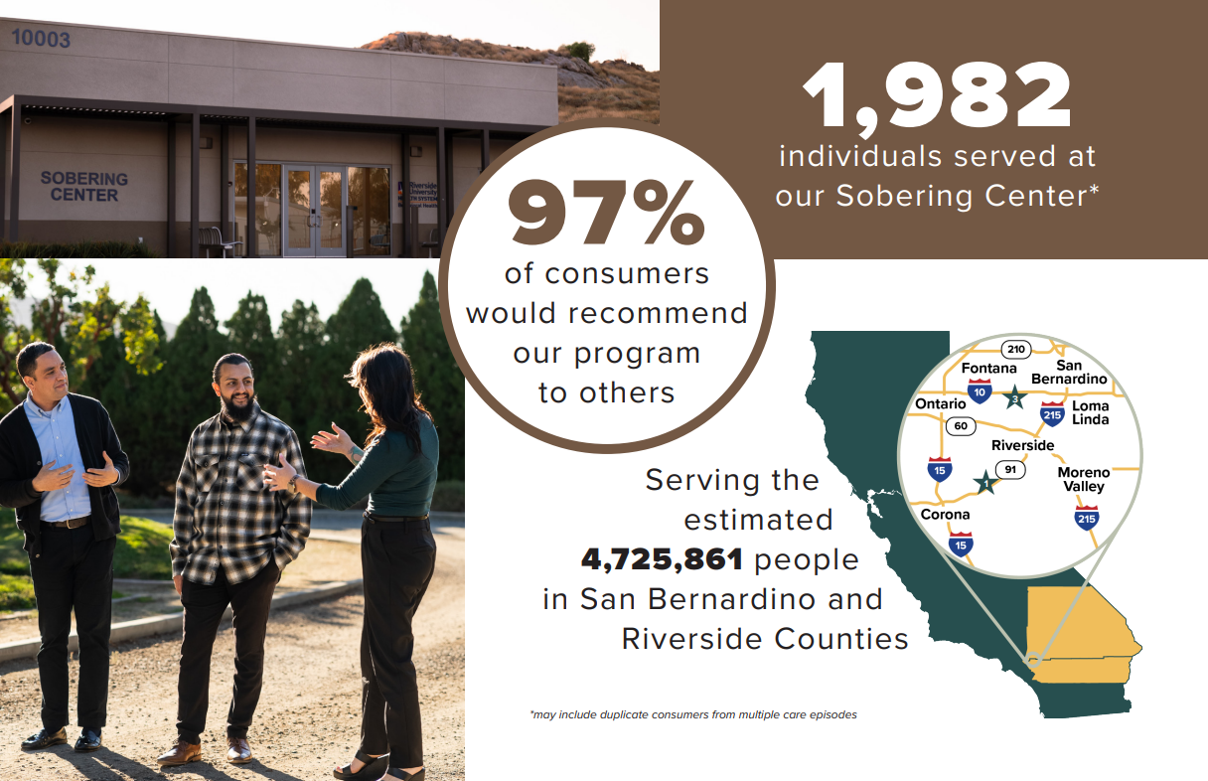
OUR IMPACT

Slide 12

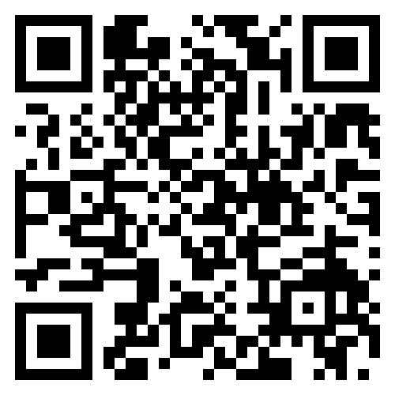
OVERDOSE
IS THE LEADING INJURY-RELATED CAUSE OF DEATH IN THE U.S.
Learn how to use naloxone and
be prepared to save a life

Slide 13
cedarhouse.org
Jared Layel
Cell: (840) 254-8566
Email: jlayel@cedarhouse.org

